Slide 1
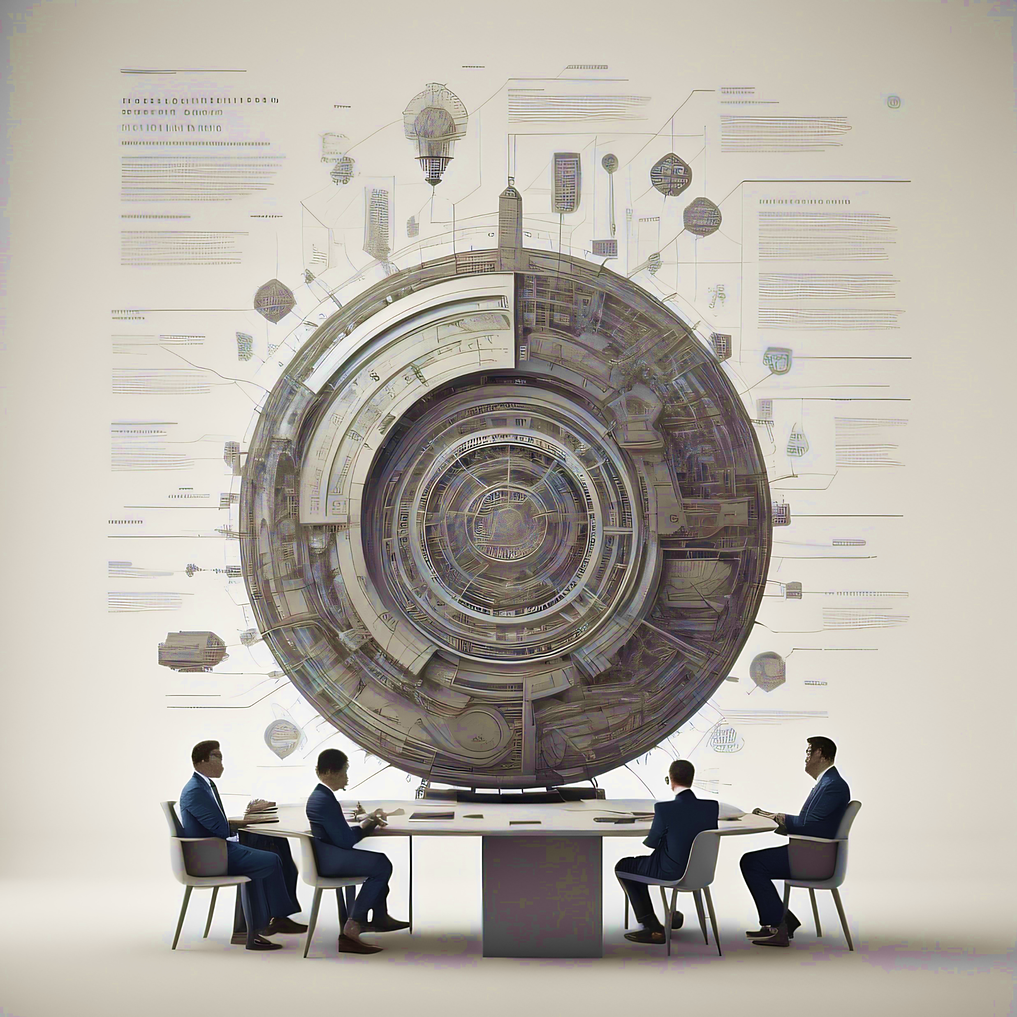
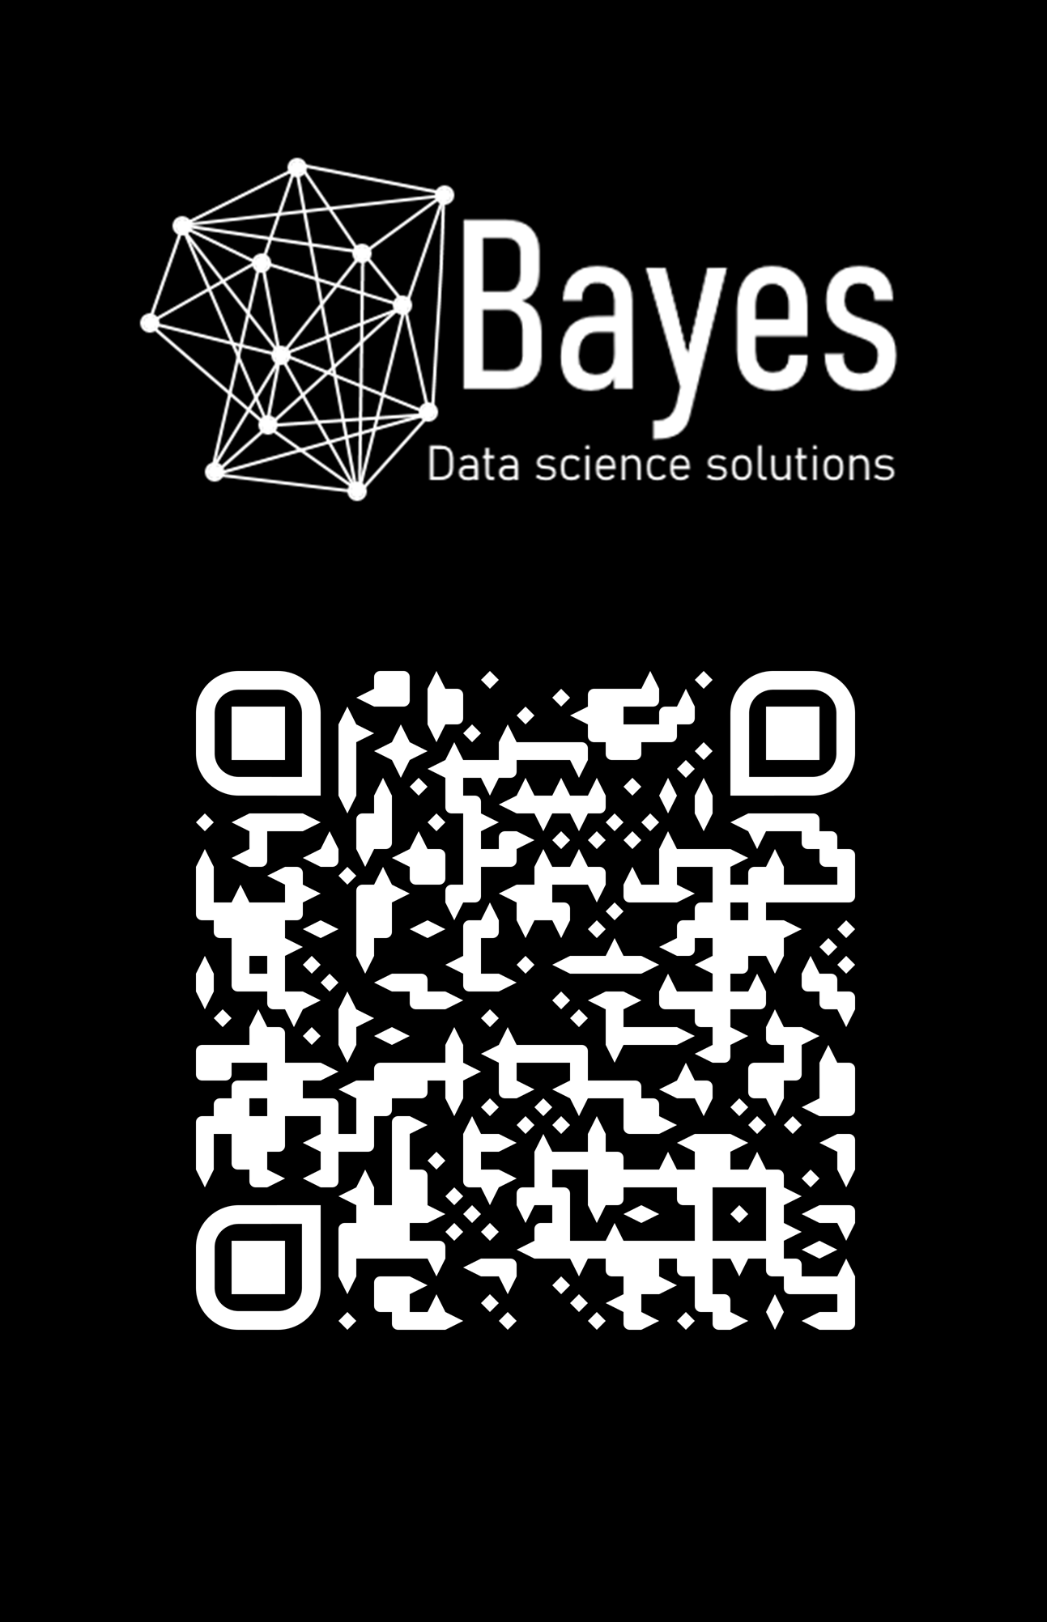
Machine Learning & Deep learning
Dr. Rolando Gonzales Martinez
Postdoctoral Fellow
Marie Skłodowska-Curie Actions
University of Groningen (the Netherlands)
Postdoctoral researcher
Oxford University (UK)

Slide 2

Learning goals
Outline
History of AI
Machine learning
Deep Learning

Slide 3
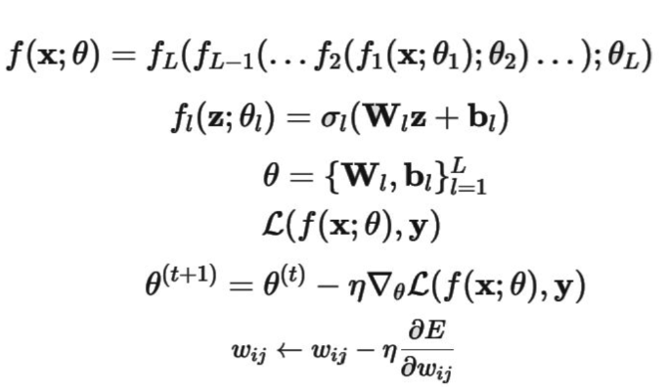
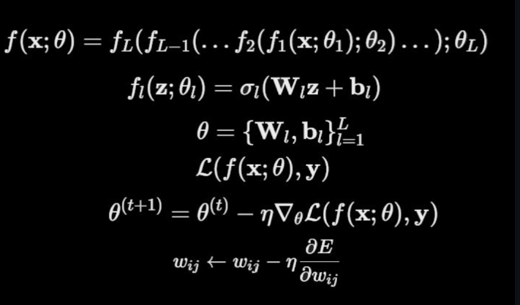
Learning goals
Outline
History of AI
Machine learning
Deep Learning

Slide 4
Learning goals
Outline
History of AI
Machine learning
Deep Learning

